Slide 1


Software Engineering Final Project

Slide 2
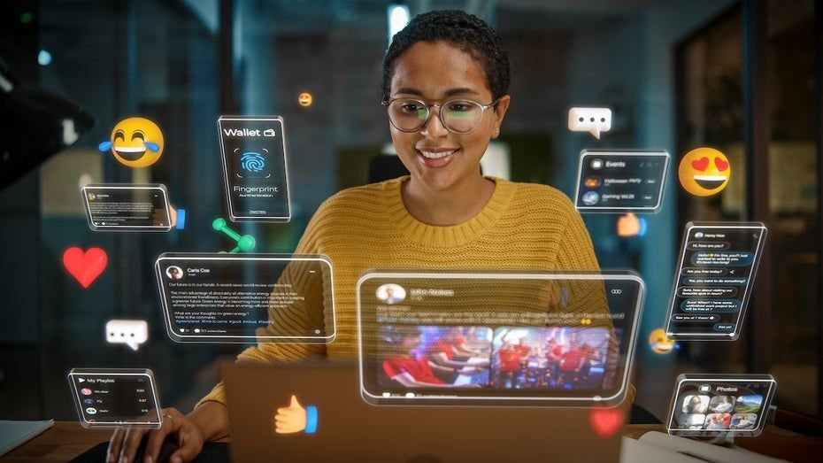

RentSure: A Digital Tenant–Property Matching Platform
Presented by: BSEM1203

Slide 3
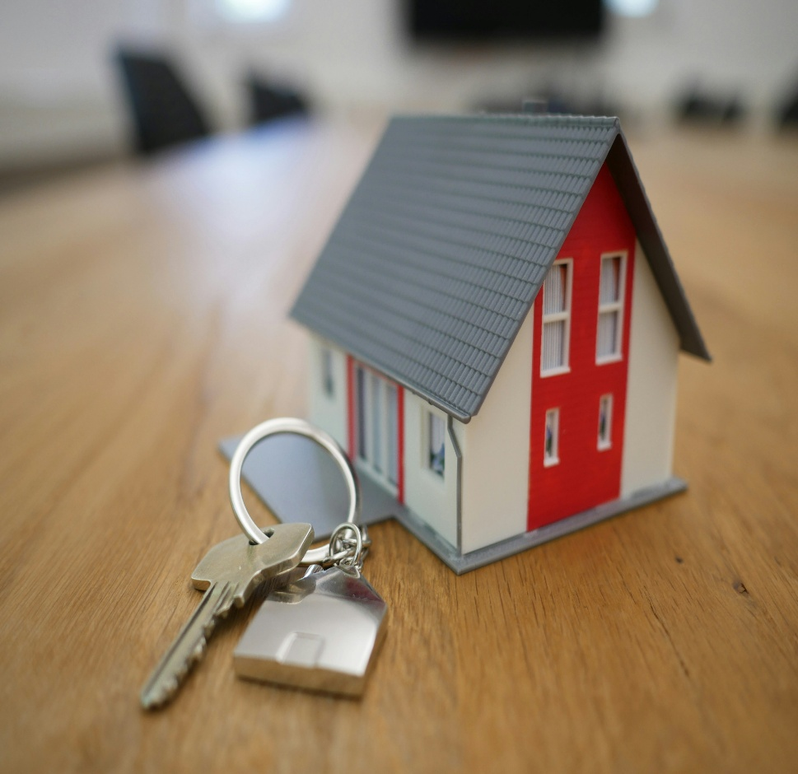
Introduction:
Background
Finding rental accommodation can be difficult.
Current methods rely on social media and referrals.
Landlords struggle to find suitable tenants.
RentSure provides a digital matching solution.

Slide 4
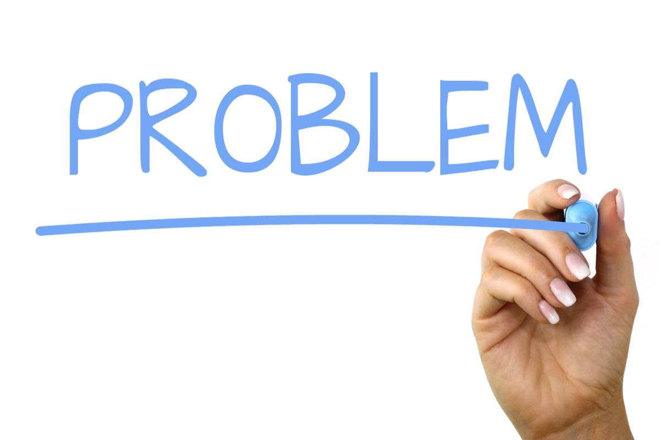
Introduction:
Problem Statement
Slow communication
Manual matching
Lack of centralized information
Time-consuming searches
Poor transparency

Slide 5

Introduction:
Existing System
Current Methods:
Facebook posts
WhatsApp groups
Phone calls
Word of mouth
Challenges:
Difficult to track
No structured matching
Time-consuming

Slide 6
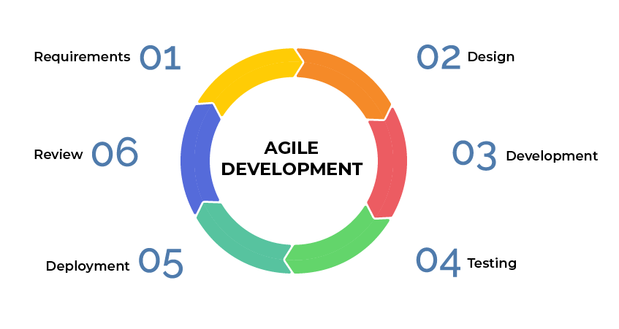
SDLC:
Agile SDLC
Stages:
Requirements
Design
Development
Testing
Deployment
Maintenance

Slide 7
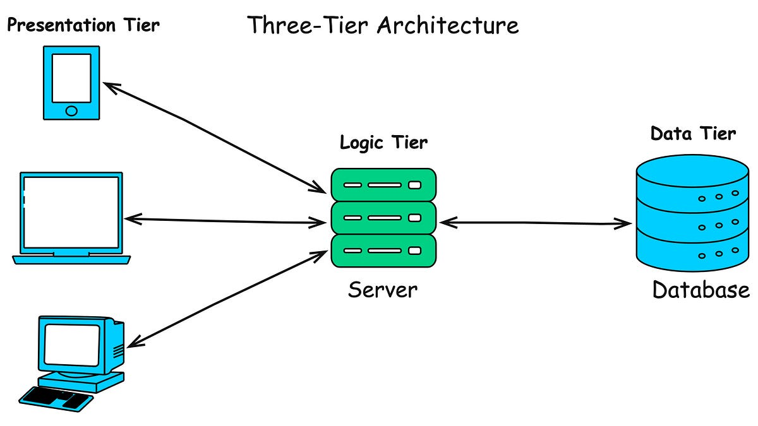
System Architecture:
Three-Tier Architecture
Presentation Layer
Business Logic Layer
Database Layer

Slide 8
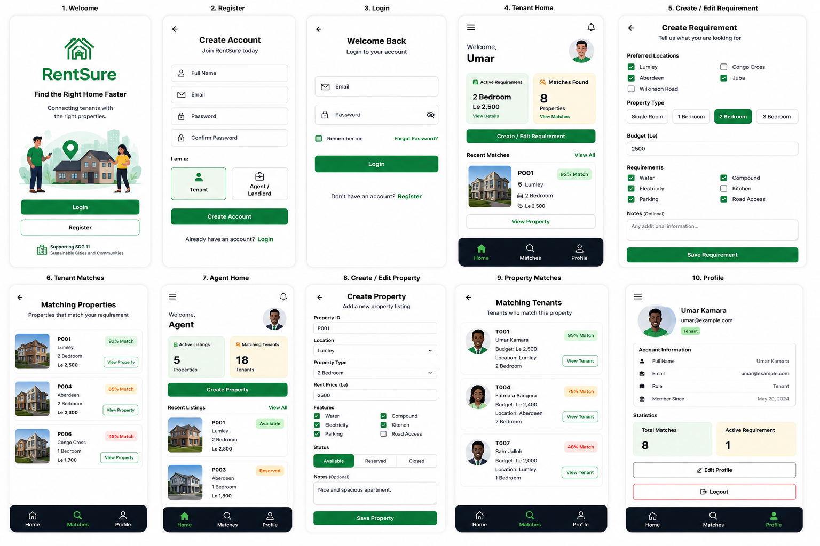
UI Prototype:
Welcome Screen
Login Screen
Registration Screen
Tenant Dashboard
Matching Properties
Property Details
Create Requirement
Agent Dashboard
Create Property
Profile Screen

Slide 9
GitHub Integration:
Benefits:
Version Control
Collaboration
Backup
Documentation

Slide 10
Project Management :
ID | Activity | Duration (Days) | Dependency
A | Requirements Analysis & MVP2 Review | 3 Days | None
B | Research & SDG Alignment | 2 Days | Requirements
C | System Design (Use Cases, UML, Database) | 4 Days | Research
D | Architecture & Prototype Design (Figma) | 3 Days | System Design
E | MVP3 Frontend Development | 5 Days | Prototype Design
F | MVP3 Backend & Database Development | 5 Days | Frontend Development
G | Testing & Validation | 3 Days | Backend Development
H | Documentation, GitHub & Final Submission | 3 Days | Testing

Slide 11
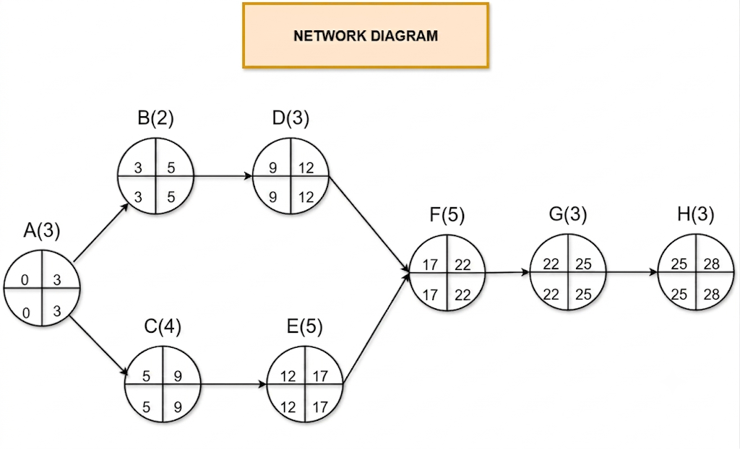
Project Management :
Network Diagram

Slide 12
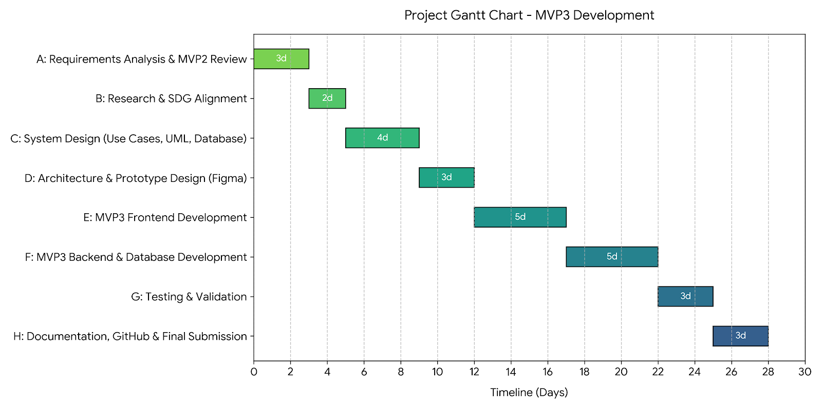
Project Management :
Gantt Chart

Slide 13
License Selection:
MIT License
Why MIT?
✔ Open Source
✔ Free to Use
✔ Easy to Understand
✔ Encourages Collaboration
✔ Supports Innovation

Slide 14
SDG Alignment:
SDG 11: Sustainable Cities and Communities
RentSure contributes by:
Improving housing accessibility
Reducing search time
Improving information transparency
Supporting digital housing services

Slide 15
Conclusion:
Future Work
Real-time messaging
Mobile application
AI recommendations
Push notifications

Slide 16
Thanks For Your Attention
☺

